Slide 1
An Introduction to Digital Marketing for Small Business Owners

Slide 2
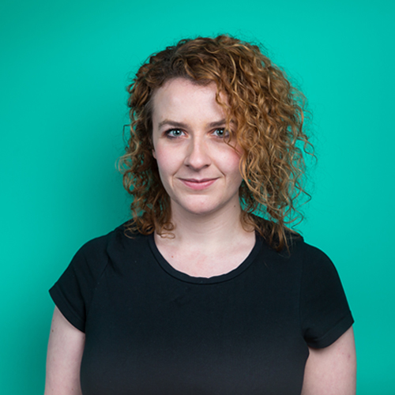
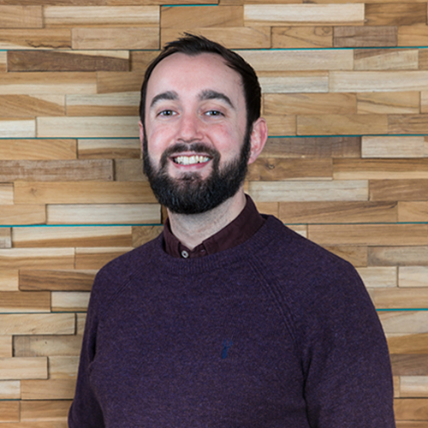
Who we are
The Bring Digital Team
Rosa Mitchell
Creative Strategy Manager
5 years experience in digital marketing
Manages award-winning PR campaigns for brands like DW Sports, Ann Summers and Stena Line
Born and bred in Liverpool
Jonny Taylor
Brand Marketing Manager
5 years experience in digital marketing
Responsible for promotion of Bring Digital and affiliated brands
Studied for 4 years in Liverpool
David Ingram
Founder and Managing Director
Over a decade of experience in digital marketing
Started Bring Digital in his spare room in 2012
Once went to Liverpool ONE

Slide 3
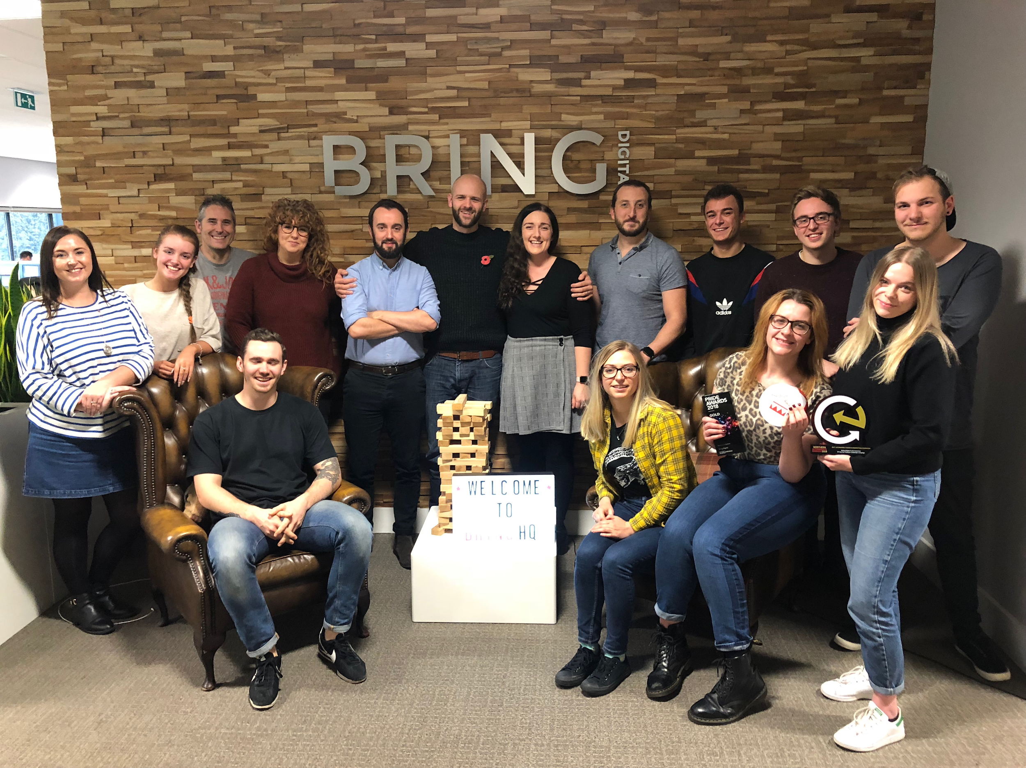
Who we are
The Bring Digital Team
Specialist digital marketing agency
50 clients in the UK and abroad
35 experts in 5 departments
One of Prolific North’s Top 50 agencies
‘Large Agency of the Year’ 2018

Slide 4
How this session will work
A quick preview
What is digital marketing?
The various avenues of digital marketing
How it applies to small businesses
Q&A

Slide 5
Question Time
“What is ‘digital marketing’?”

Slide 6
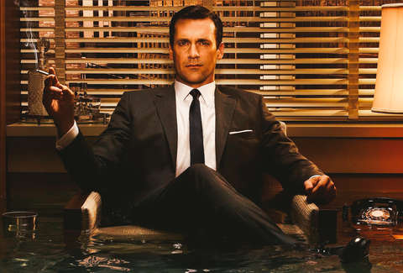
X
✔

Slide 7
Digital marketing is...
“... the marketing of products or services using digital technologies.”
Wikipedia
“... leverage digital channels such as search engines, social media, email, and other websites to connect with current and prospective customers.”
HubSpot (Leading provider of digital marketing software)
“... achieving marketing objectives through applying digital technologies and media, including the likes of search engine marketing, social media marketing, online advertising, e-mail marketing and partnership arrangements with other websites. ”
Smart Insights (Marketing advice platform)

Slide 8
Why it matters for small businesses
Businesses want...
Digital marketing provides...
Build brand awareness
Reach a global audience
at scale
A cheaper alternative to traditional marketing methods
Be profitable
Sell more stuff
Target audiences are
likely to buy

Slide 9
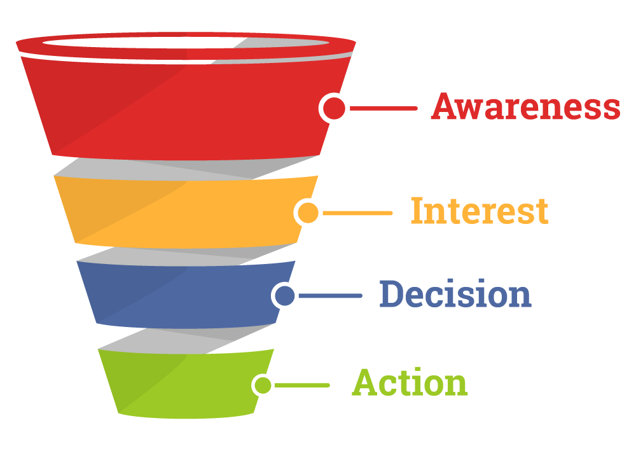
The marketing ‘funnel’

Slide 10
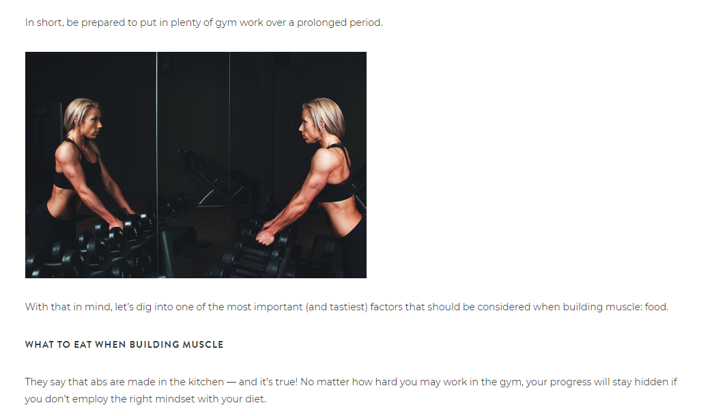
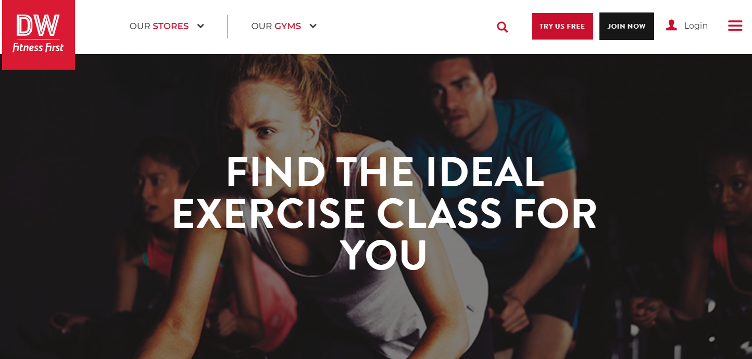
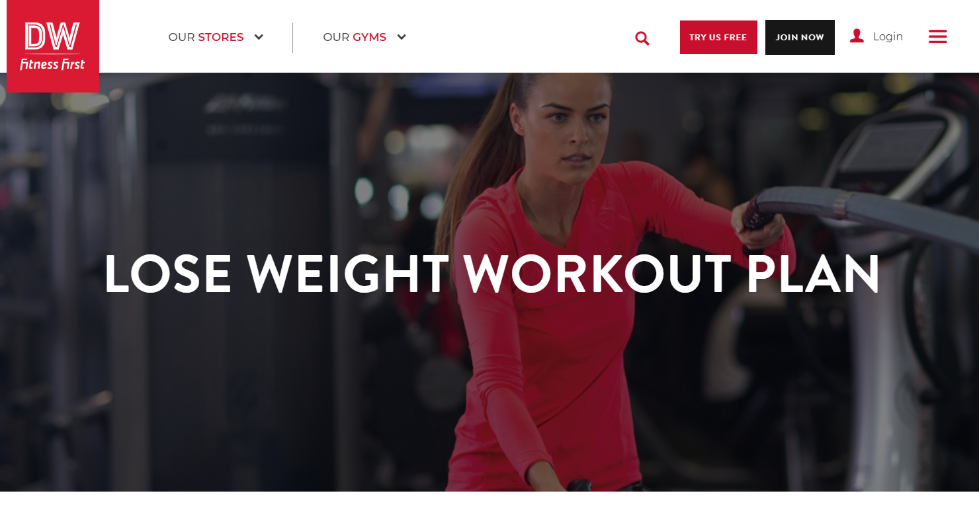
Example of the funnel in action
Awareness
Interest
Decision
Action
User
Marketer

Slide 11
PPC
Display
Paid Social
Content Marketing
Organic Social
SEO
Technical Optimisation
Web Development
Paid
Organic
Technical
Digital Marketing

Slide 12
Paid advertising

Slide 13
Paid advertising
Question Time
“Does anyone click on ads these days?”
YES!

Slide 14
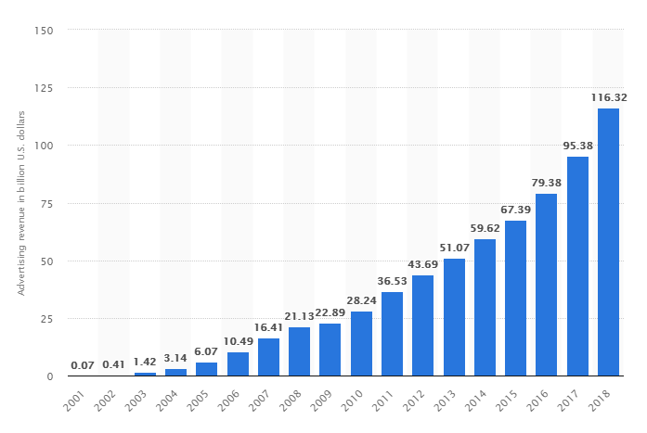
Paid advertising
The amount of money Google makes from ads in billions

Slide 15
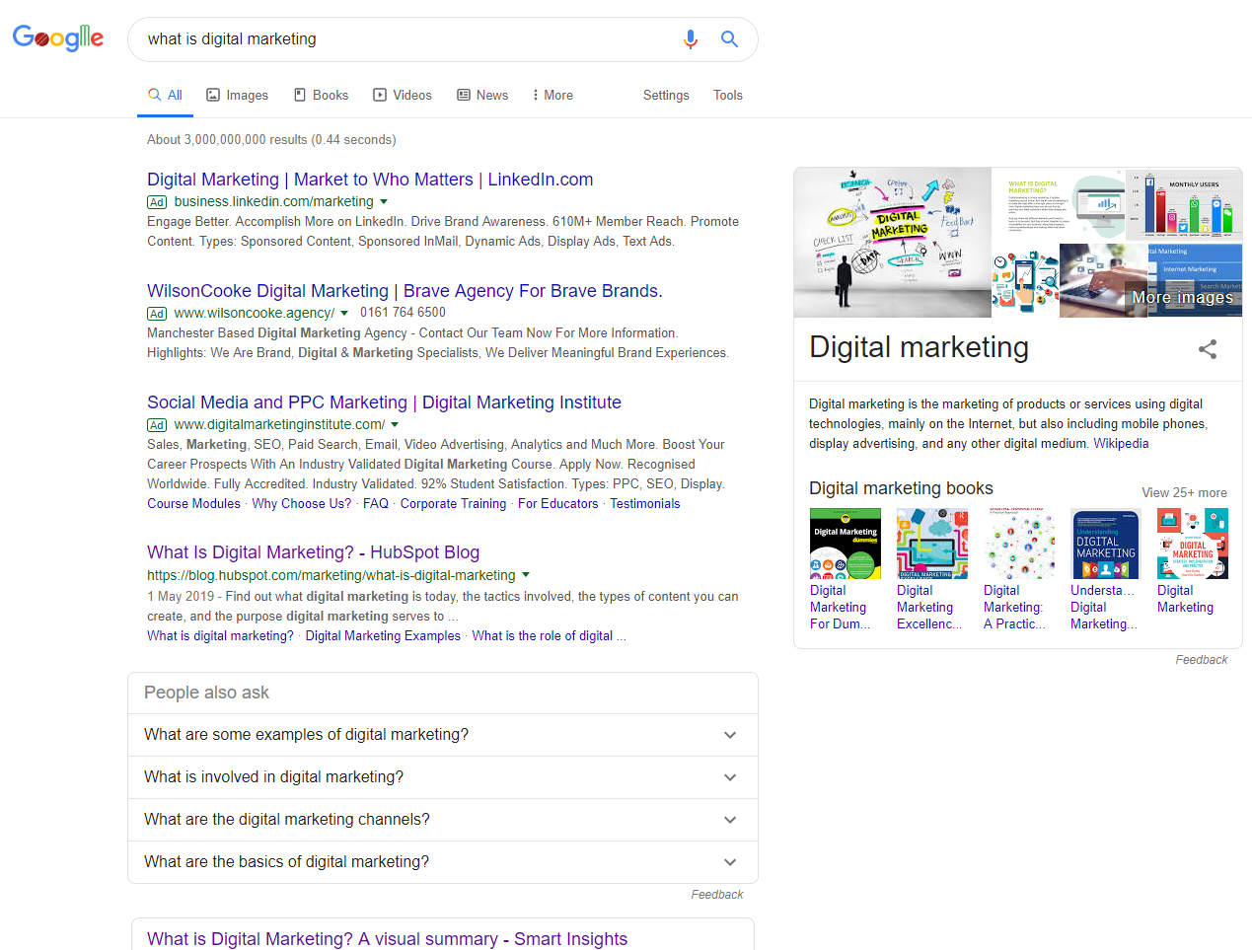
Paid advertising
Query
Ads
Organic Listings
Recommended topics
Knowledge panel

Slide 16
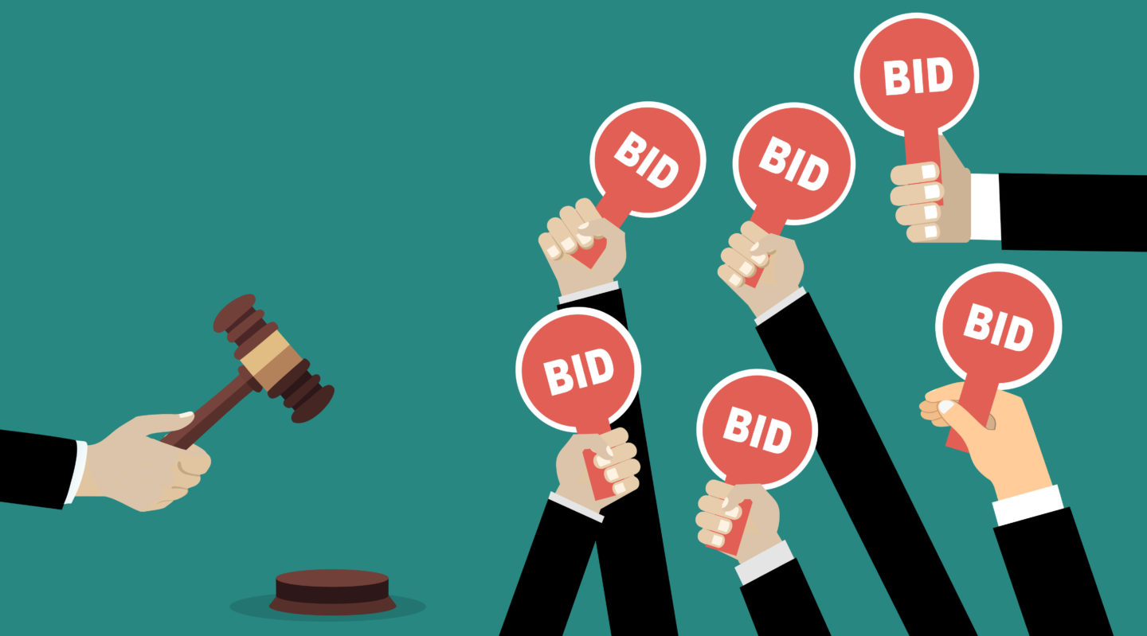
Paid advertising

Slide 17
Paid advertising
Setting up a Google ad
Choose a keyword
2. Create an ad
3. Set a maximum bid

Slide 18
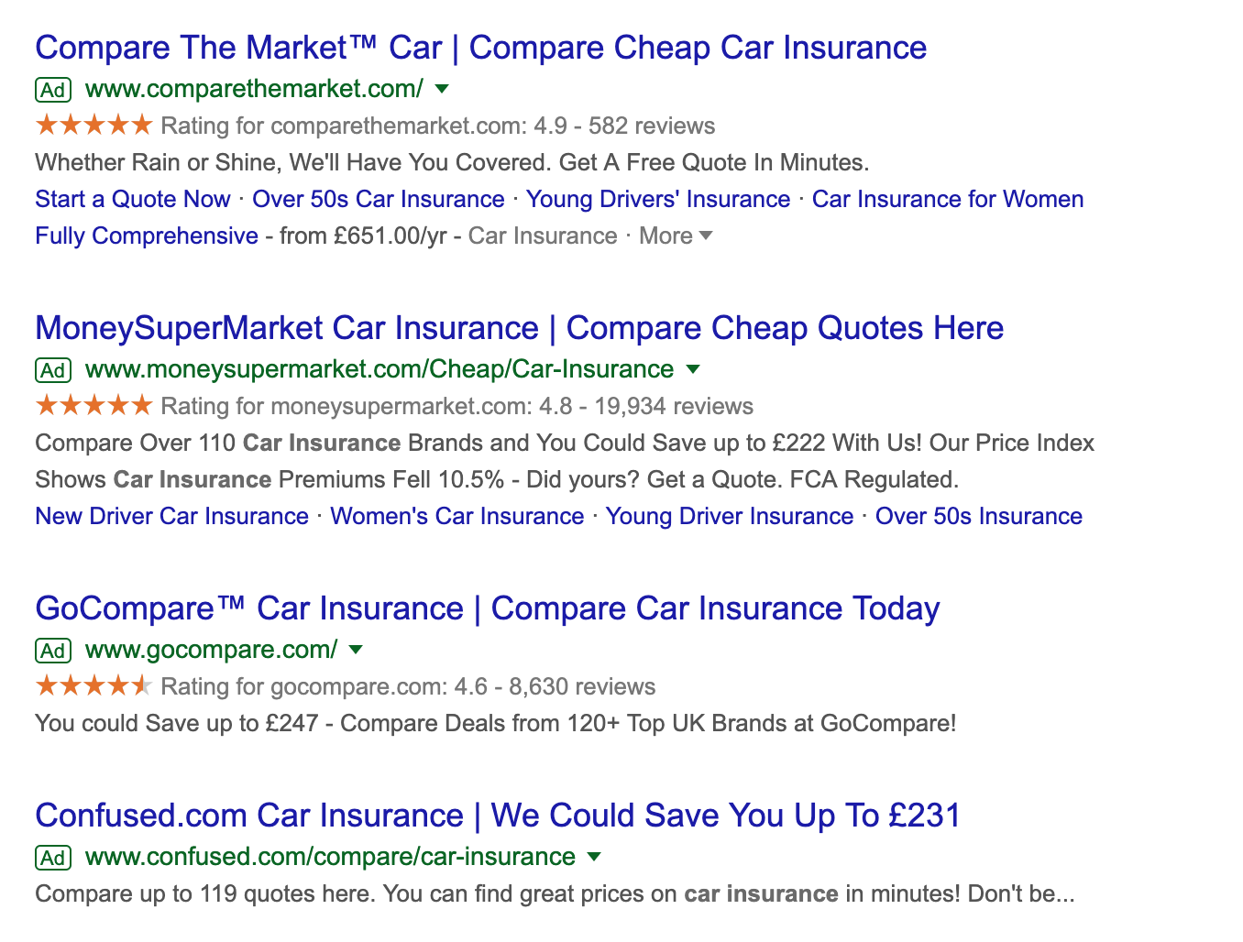
Paid advertising
Basic auction structure
Max bid: £2.00
Max bid: £1.70
Max bid: £1.10
Max bid: £0.75

Slide 19
Paid advertising
Basic auction structure
Max bid: £2.00
Max bid: £1.70

Slide 20
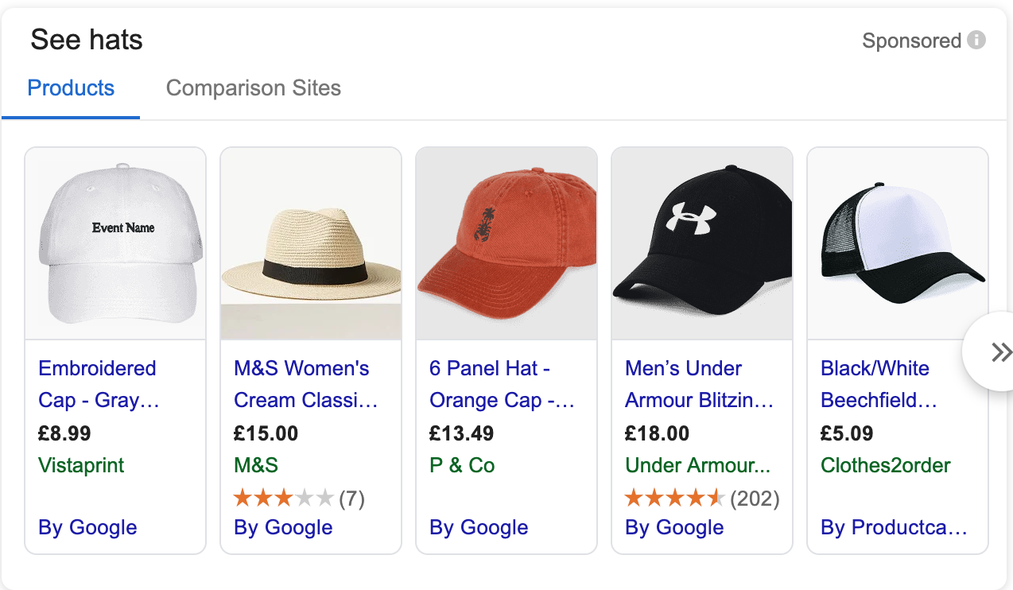
Paid advertising
Paid advertising
Google Shopping
Why use Google Shopping?
More likely to buy
By the time they’ve clicked:
They’ve seen the product
They’ve seen the price
They’ve chosen it over other products

Slide 21
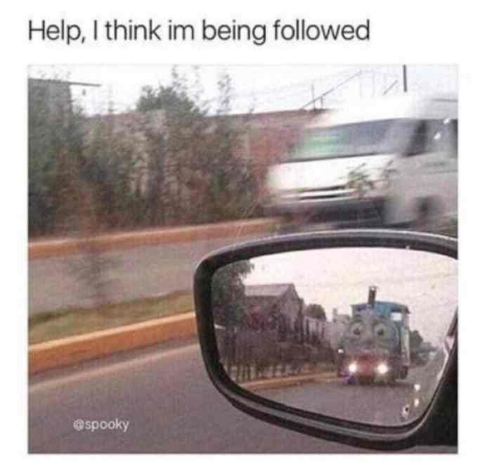
Display advertising
Remarketing
New customers in your niche
Brand exposure for your demographics
Notes:
Remarketing — Don’t wave goodbye to everyone (very cheap)
Speculative — Find new customers (e.g. gym memberships in a fitness magazine)
Brand building — Get your name in front of target audience (e.g. male in his thirties) — closest it gets to traditional advertising

Slide 22
Paid advertising
What small businesses can do
Research how much your keywords cost
Identify similar keywords you’d want to target
Keyword planner
Remarketing
Set up a remarketing audience in Google Analytics (guide in resource doc)
Products
Set up a shopping feed
Notes:
Keyword planner — How much do your keywords cost?
Set up a remarketing audience in GA (include a guide in the resources)
Retailers — Set up a shopping feed

Slide 23
Paid advertising
Useful tools

Slide 24
SEO

Slide 25
Question Time
“What does ‘SEO’ stand for?”
Search Engine Optimisation

Slide 26
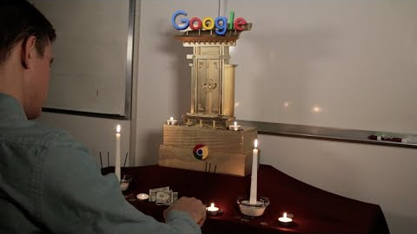
SEO

Slide 27
SEO
Query
Ads
Organic Listings
Recommended topics
Knowledge panel

Slide 28
SEO
Relevance — “Is this page relevant to what the user is searching for?”
Optimise for keywords related to the topics you want to rank for
Authority — “Is this website an authority on the topic?”
Create detailed, high-quality content informed by your expertise
Trust — “Do other websites trust this website?”
Get other websites to link to yours, preferably those that are well-known

Slide 29
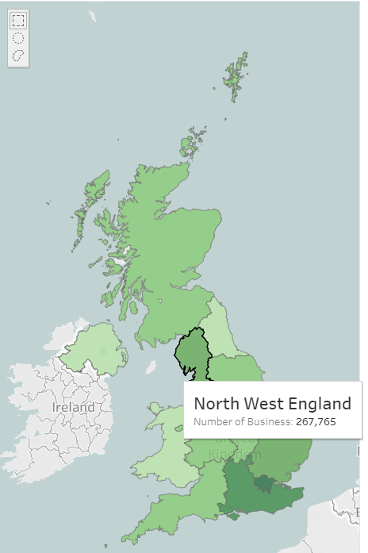
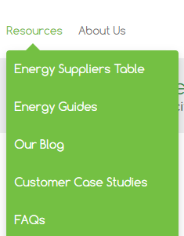
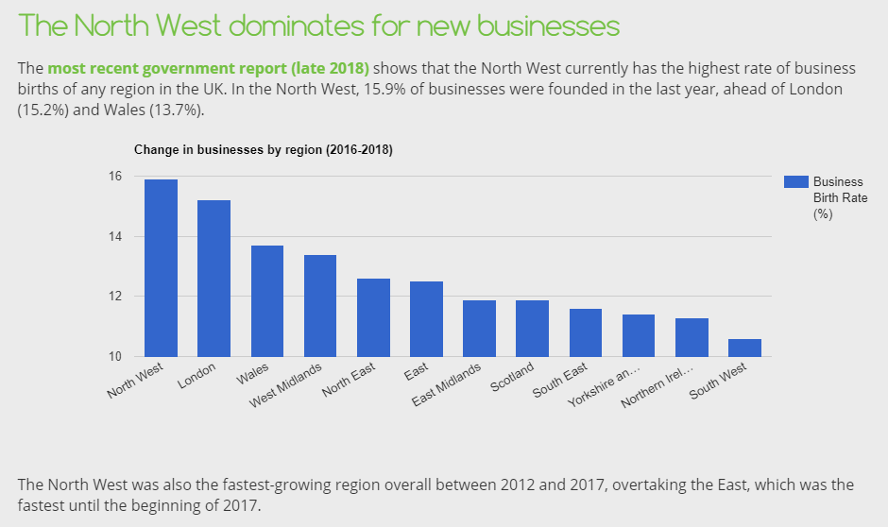
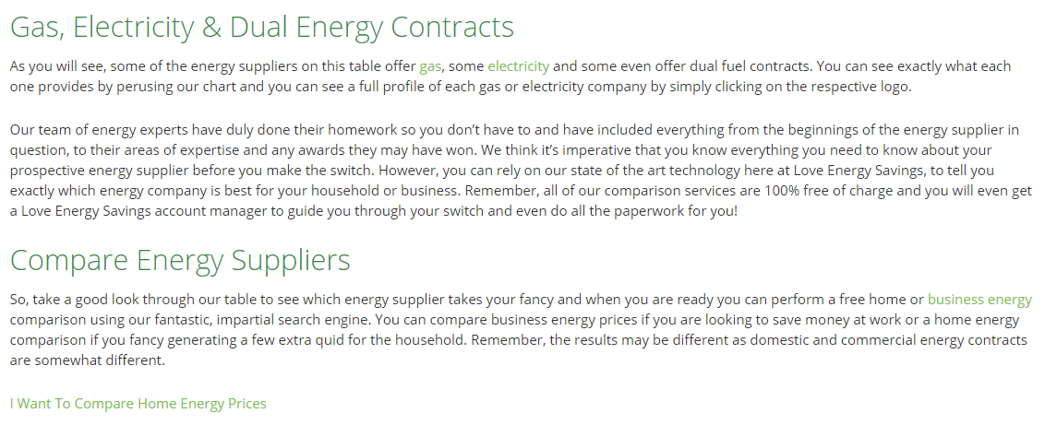
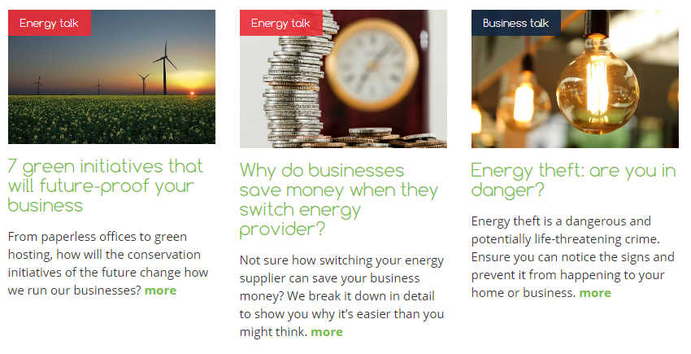
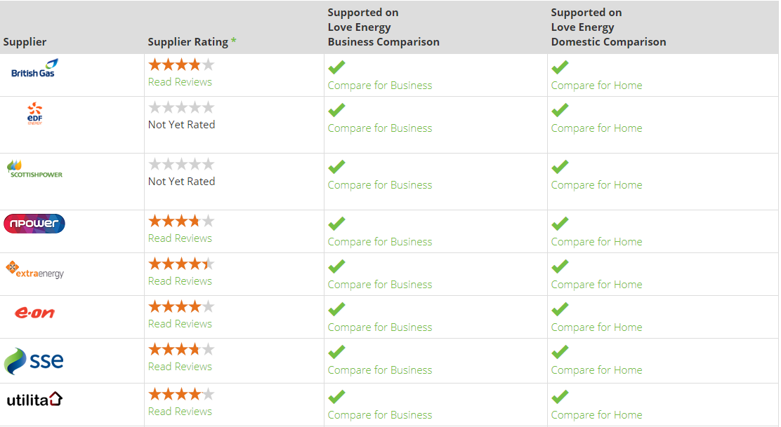
SEO
Relevance
Authority
Trust
Optimise for keywords related to the topics you want to rank for
Create detailed, high-quality content informed by your expertise
Get other websites to link to yours, especially well-established sites

Slide 30
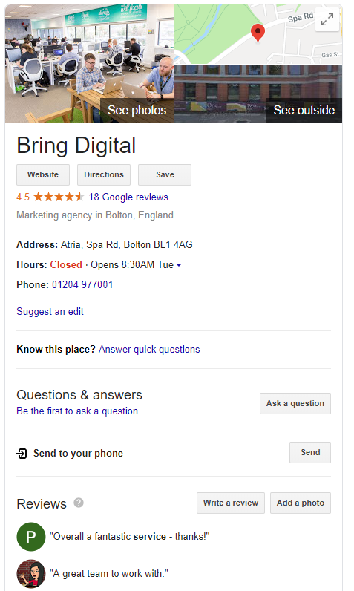
Google My Business

Slide 31
Where to start
Outline the keywords you want each of your pages to rank for
Headings
Meta information
Related topics
Share your expertise to show you’re an authority in your niche
Guides
Blog posts
In-depth product descriptions
Set up your Google My Business profile
Website
Opening hours
Reviews
Address

Slide 32
SEO
Useful free tools

Slide 33
Intermission

Slide 34
Content Marketing

Slide 35
Content Marketing
Relevance — “Is this page relevant to what the user is searching for?”
Optimise for keywords related to the topics you want to rank for
Authority — “Is this website an authority on the topic?”
Create detailed, high-quality content informed by your expertise
Trust — “Do other websites trust this website?”
Get other websites to link to yours, preferably those that are well-known

Slide 36
Content Marketing
Content Marketing
Brands
Want exposure and links
Journalists
Want a story worth sharing

Slide 37
Content marketing
Forms it can take
Blog posts
Infographics
Interactive
Video

Slide 38
Content marketing
Question Time
“What’s one example of a great piece of content you’ve seen recently?”
Discuss in pairs

Slide 39
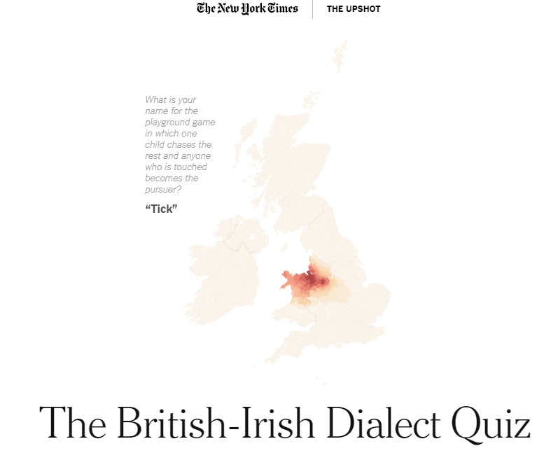
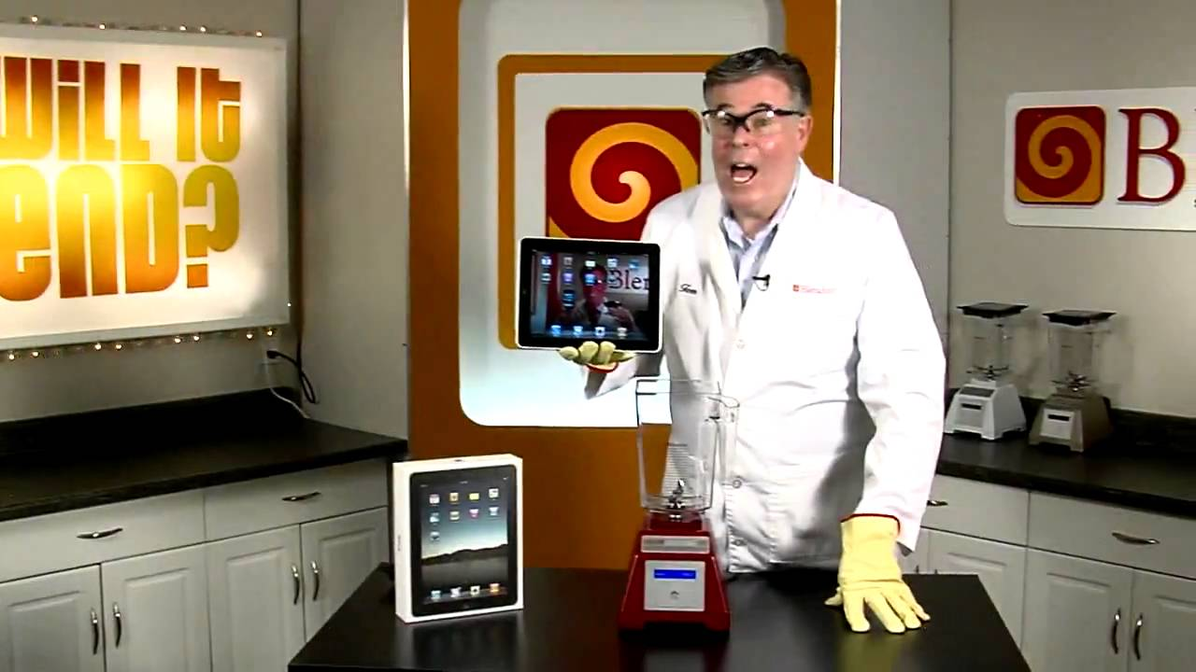
Here’s some we prepared earlier
The Logo Company
“Typography
and fonts”
The New
York Times
“The British-Irish dialect quiz”
Ikea
“TV rooms”
Blendtec
“Will it blend?”

Slide 40
Getting your content picked up
Interesting to target audience
Unique
Well-made
Make it worth sharing
Research specific journalist and bloggers
Lesser-known sites that are hyper-relevant are still highly valuable
Target the right people and publications
Prove it’s worth sharing with social metrics
Explain value to audience
Pitch it well

Slide 41
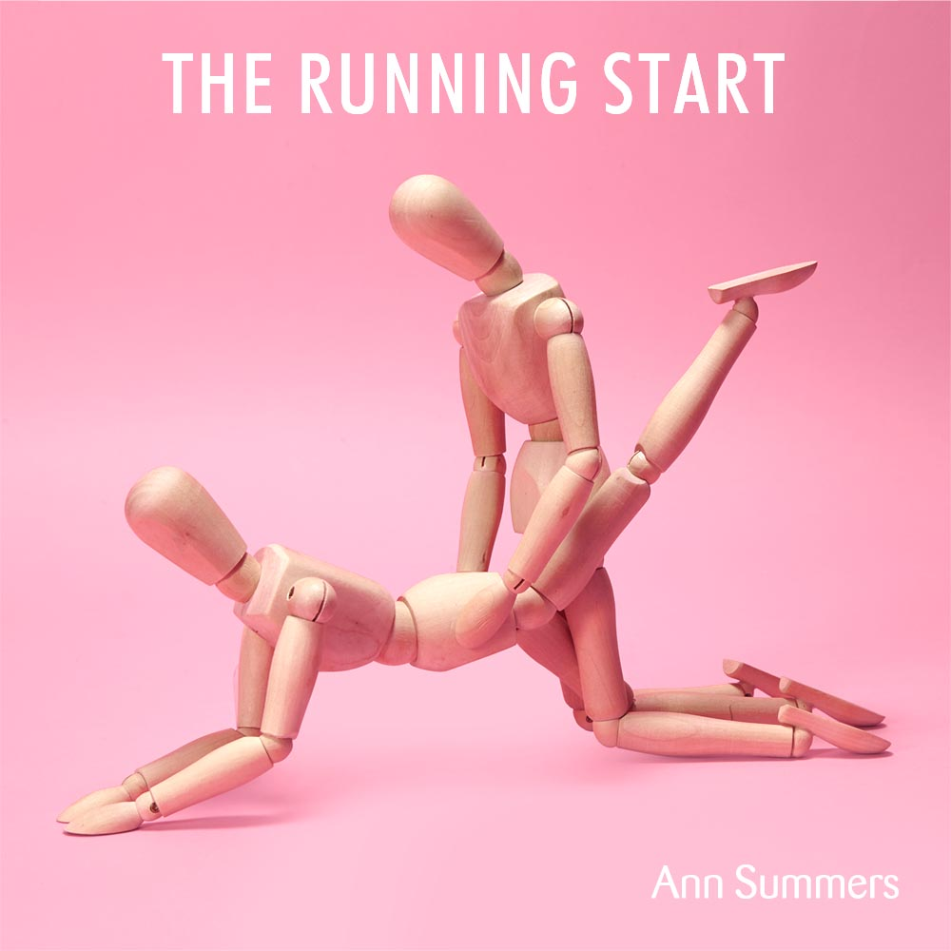
Case study

Slide 42
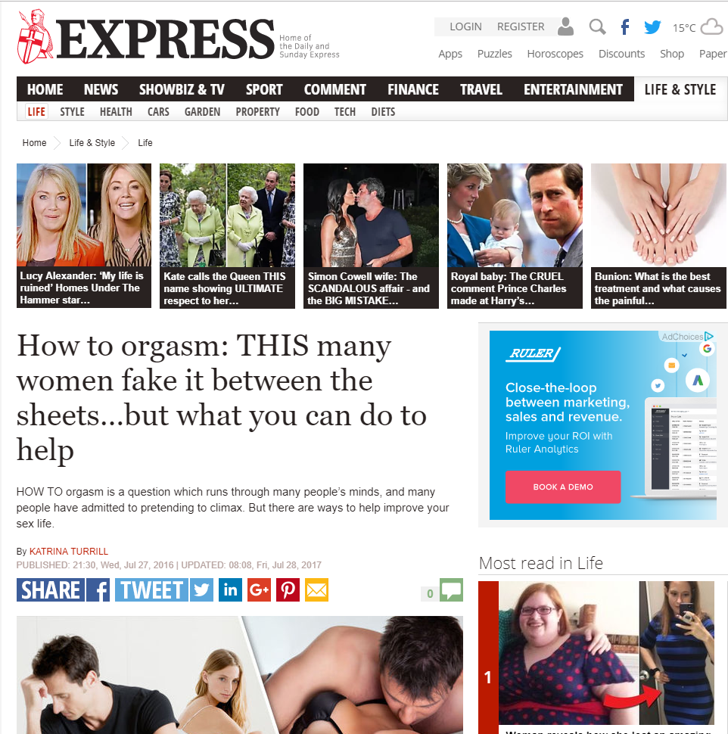
Case study
Step 1: Research
Good coverage
Most-read blog posts

Slide 43
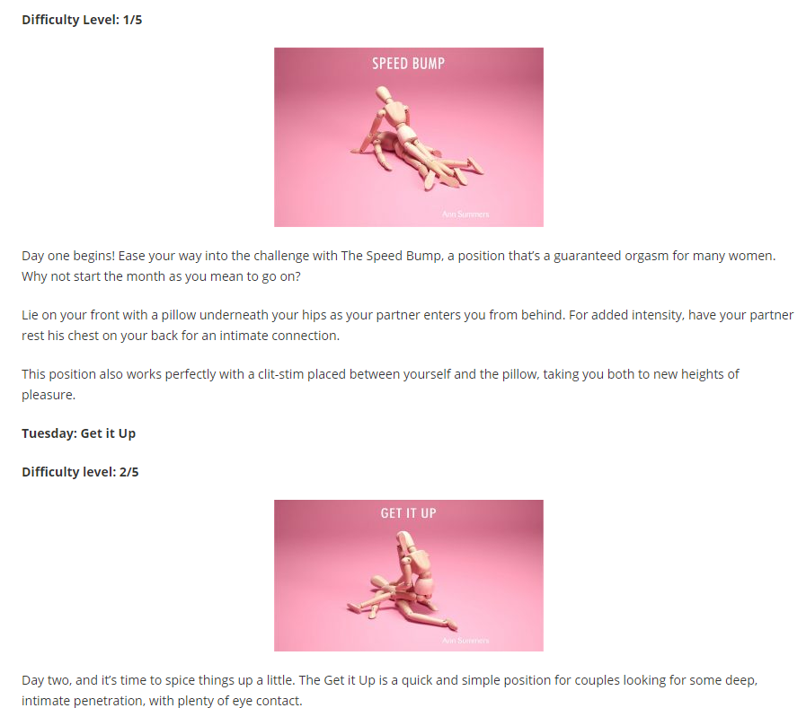
Case study
Step 2: Creation and outreach
Tabloids
Women’s Interest
Health

Slide 44
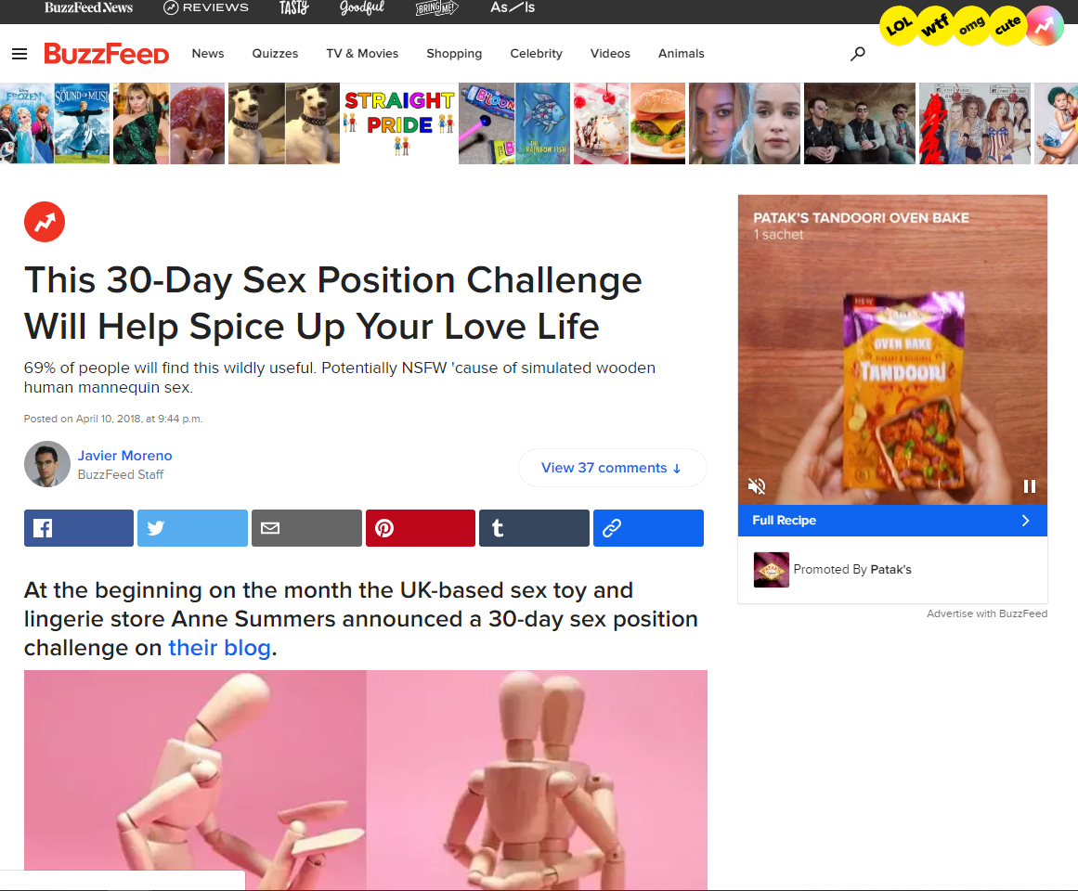
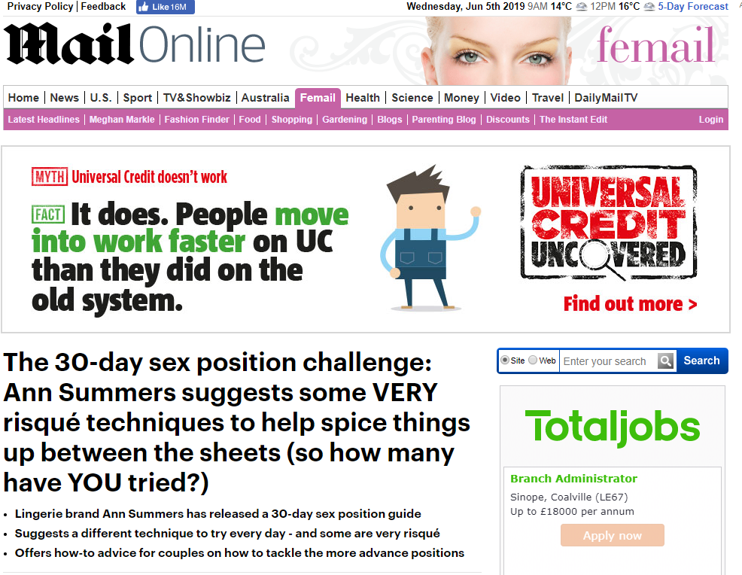
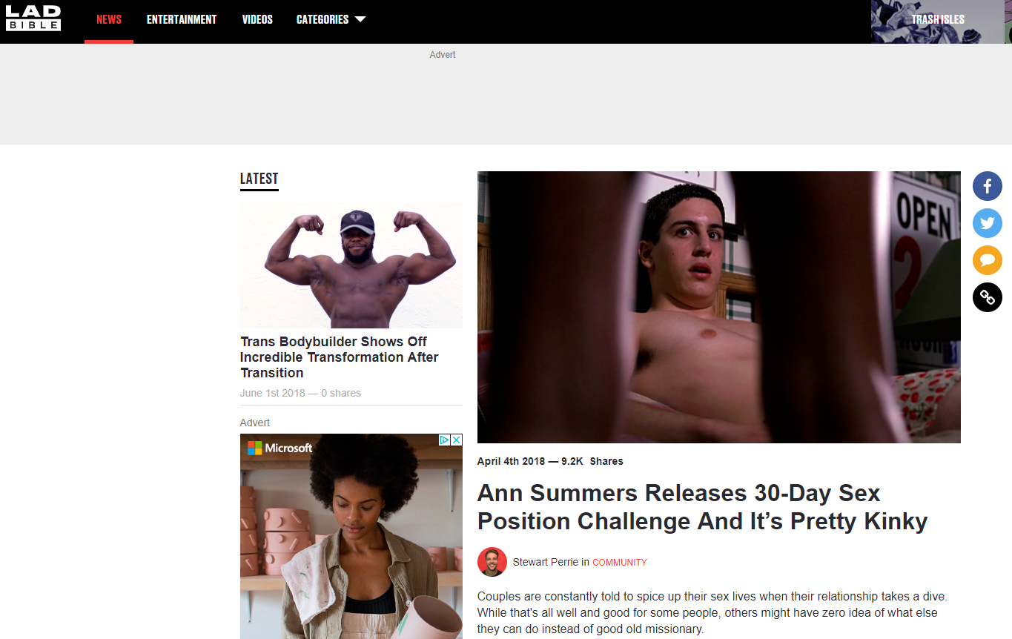
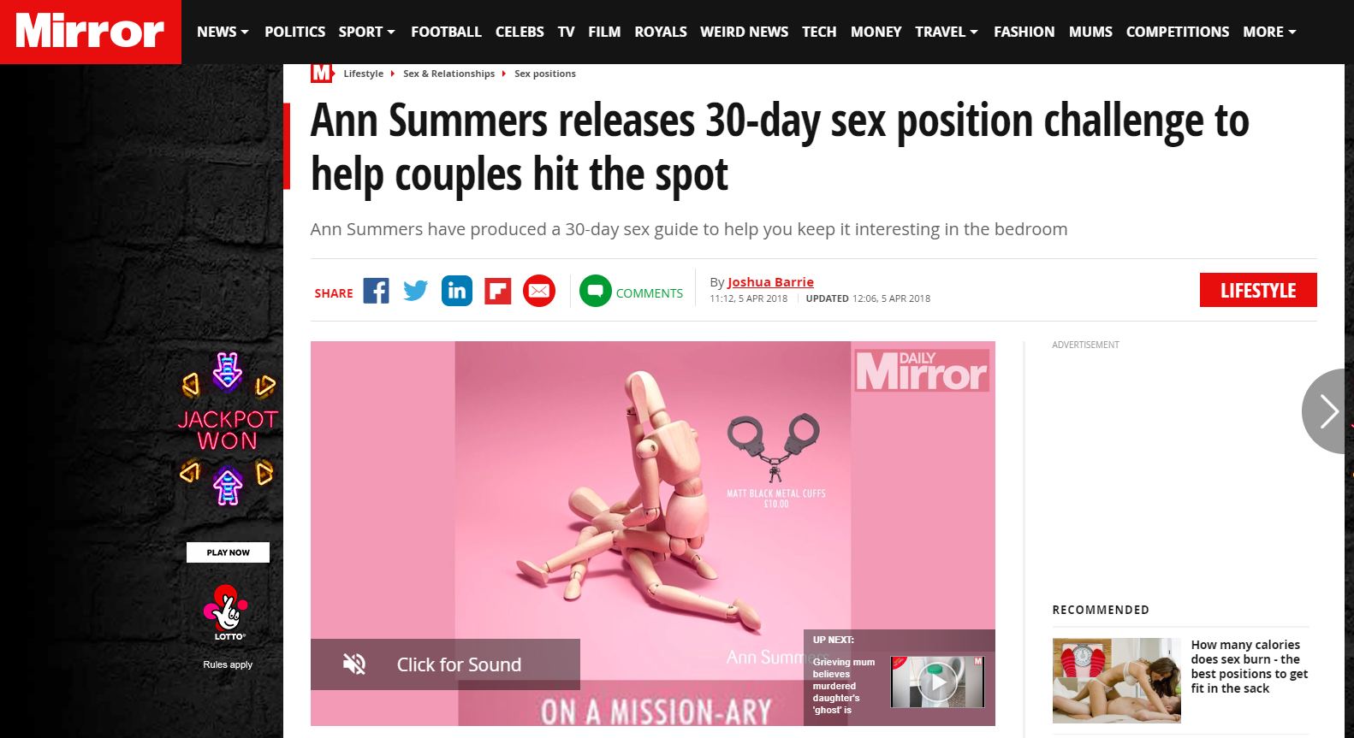
Case study
Step 3: Results

Slide 45
Case study
Step 3: Results
89
pieces of coverage
2.7 million
views
117,000
Visits to the Ann Summers website
58,600
Social shares

Slide 46
What small businesses can do
Decide what kind of content you want to create
Create a content calendar
Start conversations with relevant bloggers

Slide 47
Useful content marketing tools

Slide 48
Social media

Slide 49
Social media
Question Time
“What is your favourite brand to follow on social media and why?”
Discuss in pairs

Slide 50
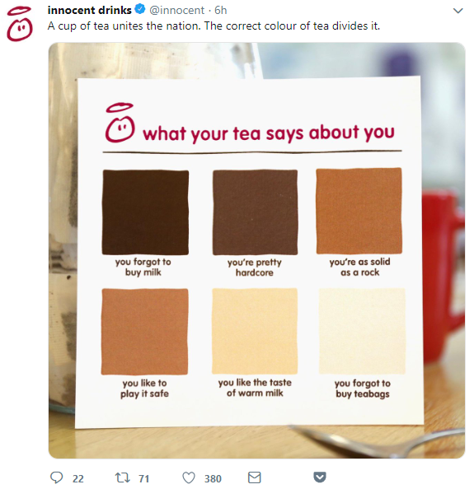
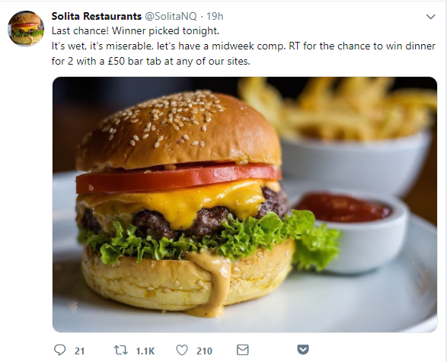
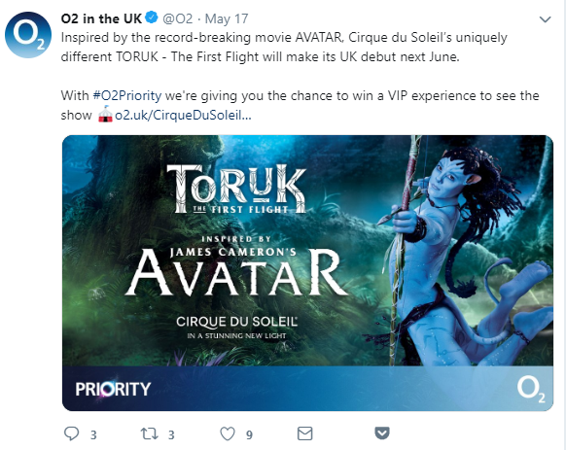
Social media
Examples of great social media accounts
Innocent Smoothies
Solita
O2

Slide 51
Social media
Engage with followers
Strategy
Promote products and services
Build partnerships

Slide 52
Planning posts
Social media scheduling software

Slide 53
Social media
Scheduling posts

Slide 54
Social media
Increasing engagement
Conversation is king
Ask questions in posts
Reply to threads
Start a group for your niche
Build
partnerships
Shout-outs with tags
Cross-brand promotions
Get buy-in from micro-influencers
Incentivise
Competitions
Exclusive discounts
Share useful content

Slide 55
Social media
Case study

Slide 56
Social media
Paid advertising
Types of ads
Photo ads
Video ads
Story ads
Carousel ads

Slide 57
Social media
Paid advertising
Tips
Test on organic
What gets the most likes or clicks?
Select the right platform for your ads
Visual product-led — Instagram
Story-led ad — Facebook
Demographics
Creative
Retargeting
Experiment with targeting

Slide 58
Social media
Useful tools

Slide 59
Question time!

